Slide 1

EDa – Healthcare persistancy
By Shuyi Yu
Intern 2024
10/11/2024

Slide 2
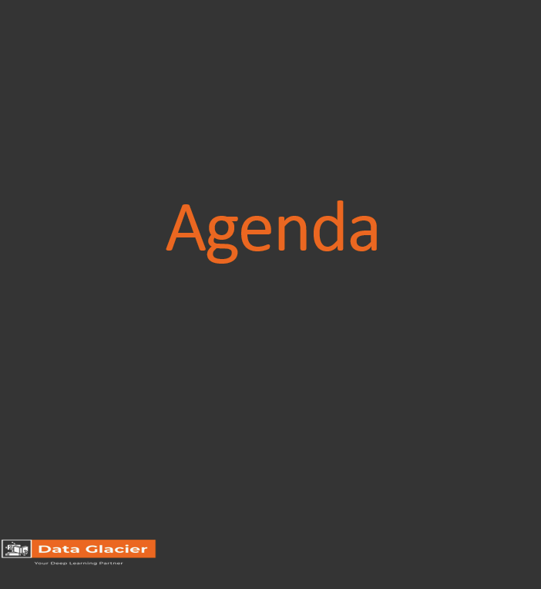
Execution Summary
Introduction to Healthcare Persistency
Problem Statement
Approach
EDA
key Insights from the EDA
Business Recommendations
Technical Recommendation

Slide 3
Executive Summary
ABC Pharma Company, representation of what the rest of the industry also finds challenging, is experiencing a difficulty in understanding drug persistency, which refers to whether patients continue their prescribed treatments.
This presentation will be judged based on the visuals provided, the quality of the analysis and the value of the recommendations and insights.
The company seeks to automate the identification process of patients at risk for non-persistence, bringing in real patient's data analytics to analyze patient demographics, comorbidities, risk factors, and treatment details to make informed decisions that support both physicians and patients.

Slide 4
Introduction to Healthcare Persistency
Definition of Persistency:
Persistency refers to patients consistently adhering to prescribed treatments over time. We aim to analyze the factors related to persistency to help healthcare providers improve patient adherence.
Importance of Persistency:
Maintaining persistency in treatments is vital for improving patient outcomes and reducing healthcare costs. By understanding which factors are correlated with higher persistency rates, healthcare providers can take action to support at-risk patients.

Slide 5
Problem Statement
By the end of this Exploratory Data analysis the following problem statements will be answer in each slide to ultimately decide which cap business to invest on:
What are the Key Demographics of the Patient Population and Relationship with Persistency?
What are the Medical Factors and Their Relationship with Persistency?
What are the Comorbidities and Their Impact on Persistency?
What are the Risk Factors and Their Correlation with Persistency?

Slide 6
Approach
In the EDA (Exploratory Data Analysis) approach for the healthcare persistency project, it is focused on uncovering relationships between key variables and the target variable (Persistency_Flag) to provide actionable insights. Here is the step-by-step explanation of the approach:
Data Understanding and Preparation:
  categorical and numerical columns
  Data: c_Healthcare_dataset.csv
Data Cleaning and Encoding:
  Binary Encoding
  One-Hot Encoding
  Ordinal Encoding
Exploring Relationships:
  Chi-Square Tests for Categorical Variables
  Correlation Heatmap
Key Insights from EDA:
  Medical Factors
  Risk Factors and Comorbidities
Feature Importance:
  Top Features:
Visualizations:
  Matlibplot
  Seaborn

Slide 7
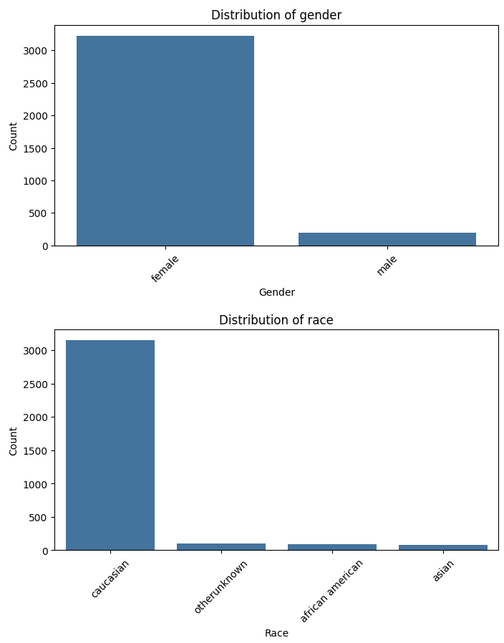
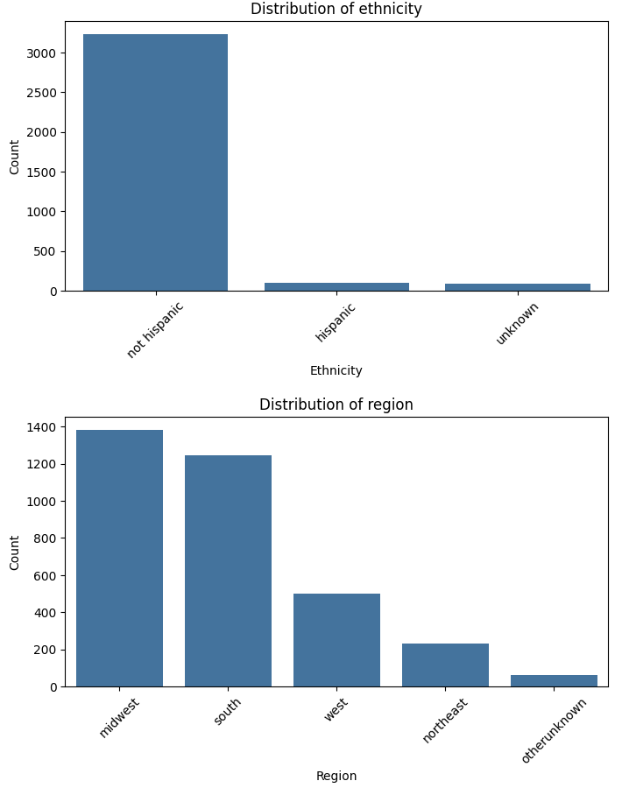
Hypothesis 1: What are the Key Demographics of the Patient Population and Relationship?
Age: Patients aged 55-75 are more persistent.
Gender: No significant difference in persistence.
Region: Higher persistency in the Northeast and West; lower in the South.

Slide 8
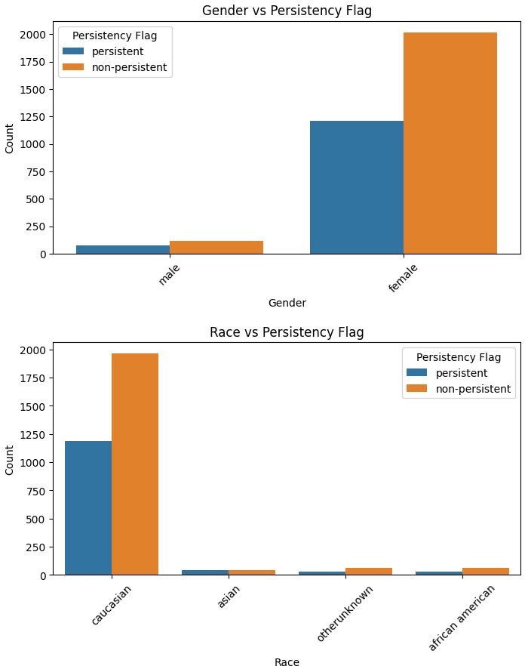
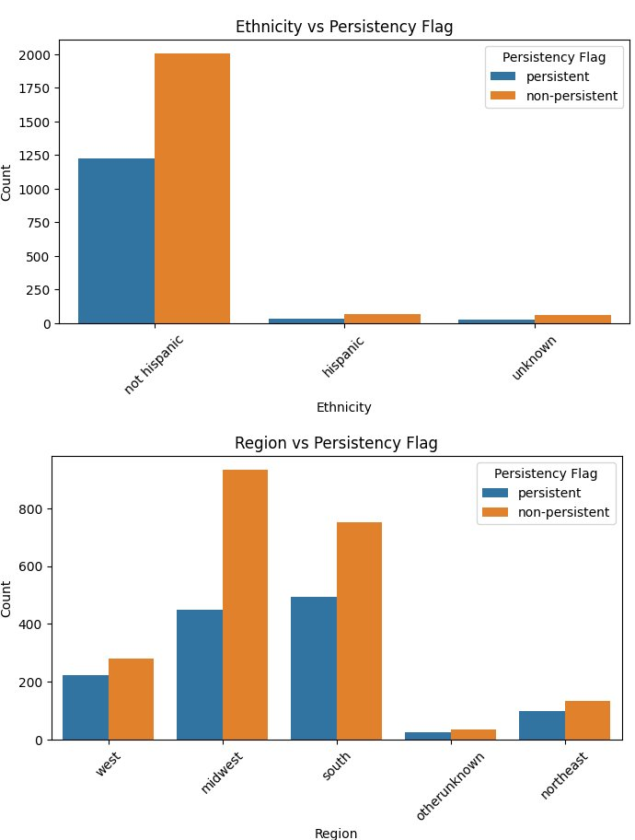
Hypothesis 2: What are the Key Demographics of the Patient Population and Relationship?
Age: Patients aged 55-75 are more persistent.
Gender: No significant difference in persistence.
Region: Higher persistency in the Northeast and West; lower in the South.

Slide 9
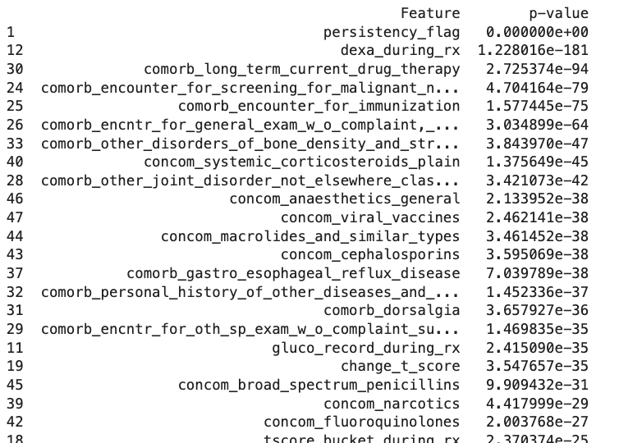
Hypothesis 3: What are the Medical Factors and Their Relationship with Persistency?
DEXA Scans: Strong correlation with persistency; regular scans improve adherence.
Long-Term Therapy: Patients on long-term therapies are more persistent.

Slide 10
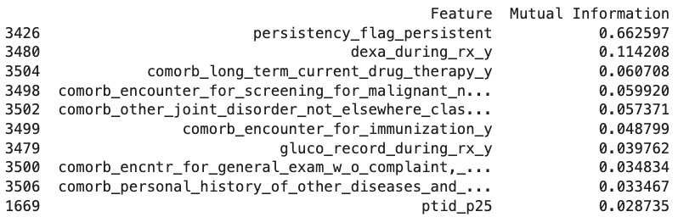
Hypothesis 4: What are the Comorbidities and Their Impact on Persistency?
Cancer Screenings: Higher persistency in patients who underwent cancer screenings.
Chronic Conditions: Conditions like GERD and Vitamin D Deficiency linked to higher persistency.

Slide 11
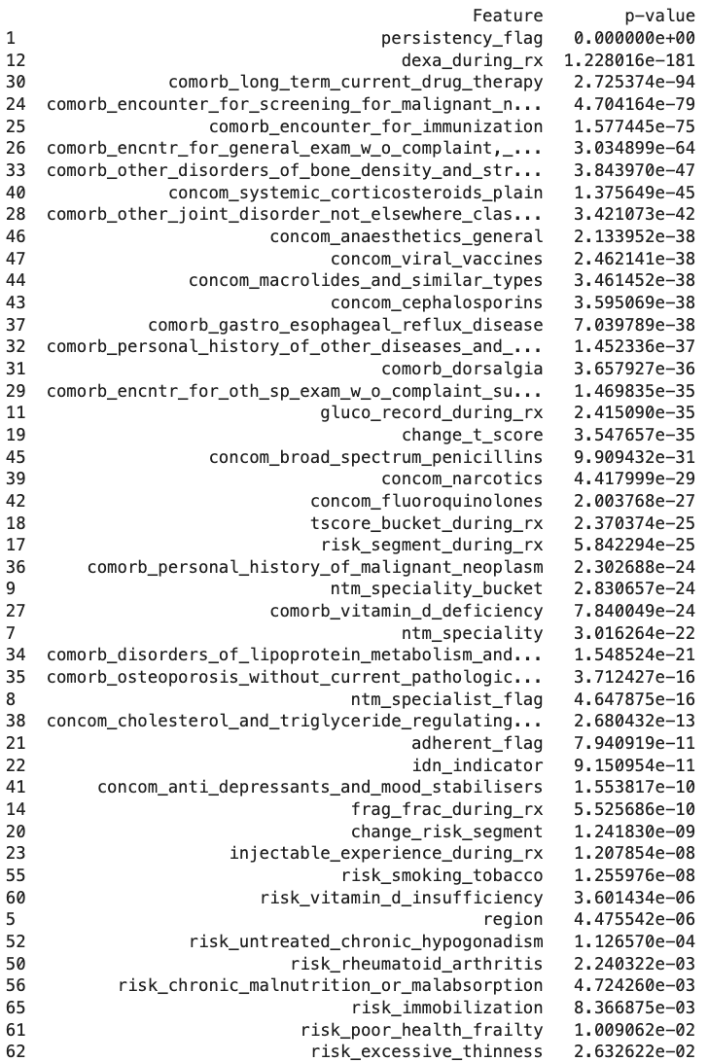







Hypothesis 5: What are the Risk Factors and Their Correlation with Persistency?
Vitamin D Deficiency: Linked to lower persistency.
Low Calcium Intake: Also associated with lower adherence.
Chronic Disease Risks: Lower persistency among patients with chronic malnutrition, liver disease, etc.

Slide 12
the key Insights from the EDA
Age & Region: Persistency higher in older patients and those in the Northeast/West.
Monitoring & Therapy: Regular monitoring (e.g., DEXA scans) improves persistency.
Chronic Conditions & Nutrition: Address deficiencies to improve adherence.

Slide 13
Business Recommendations
Based on the data and the plotted visualizations show that:
Targeted Regional Efforts: Improve persistency in the South with focused interventions.
Nutritional Support: Address Vitamin D and Calcium deficiencies to boost adherence.
Proactive Monitoring: Increase regular health checks for at-risk groups.
Overall, these insights strongly suggest that ABC Pharma Company should create such predictive system for their operations to be more efficient on primary business goals, like reducing costs or improving patient adherence. However, medical experts should still need to be inspecting and validation cases in which patients that are in moderate or high risk.

Slide 14
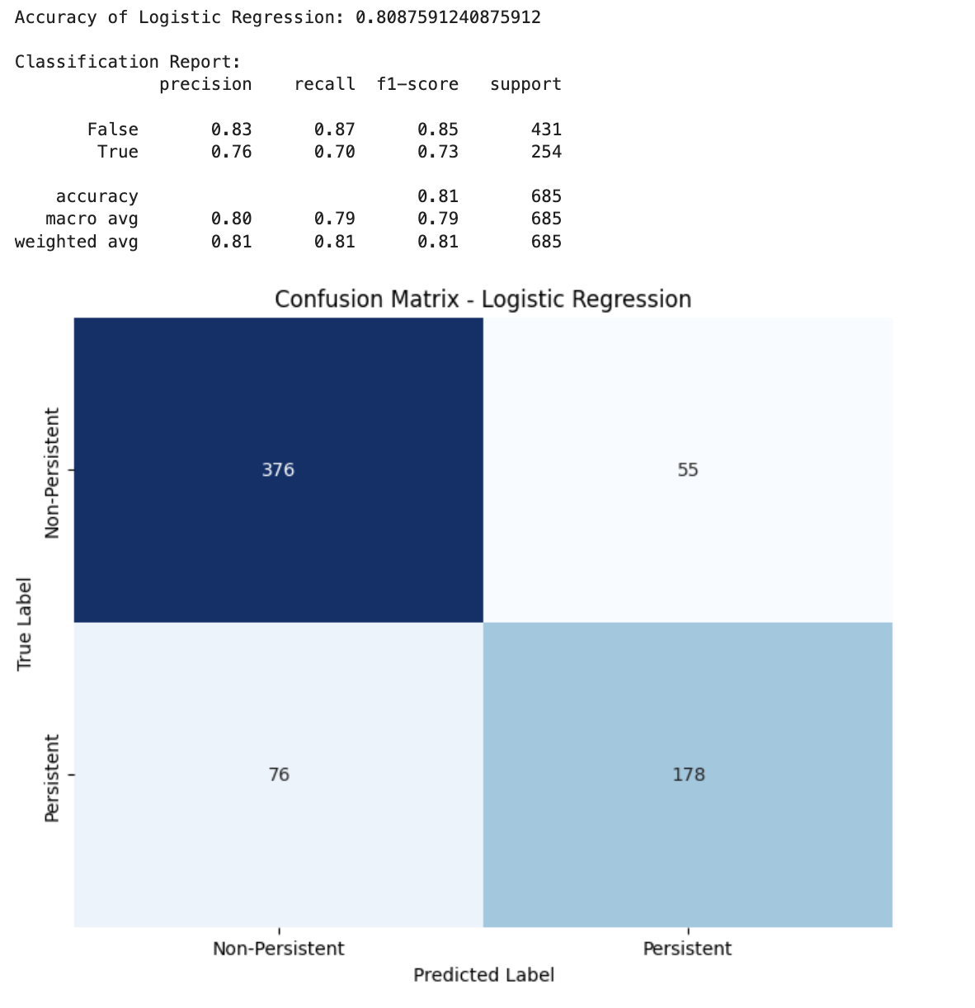
Technical Recommendations
Recommended Models for Persistency Prediction:
Logistic Regression (L2 Regularization):
Best suited for the dataset, offering a balance between interpretability and performance with an accuracy of 80%. This model allows us to pinpoint which features (e.g., DEXA scans, comorbidities) are the most predictive of persistency.
Random Forest:
Random Forest performed slightly lower than Logistic Regression but excels in capturing non-linear relationships. This model is recommended for exploring feature importance, particularly for categorical data like regions and comorbidities.
XGBoost:
Recommended for more complex, non-linear relationships. While not yet fully tested on this dataset, it is likely to outperform Logistic Regression and Random Forest in cases where feature interactions significantly impact persistency.

Slide 15
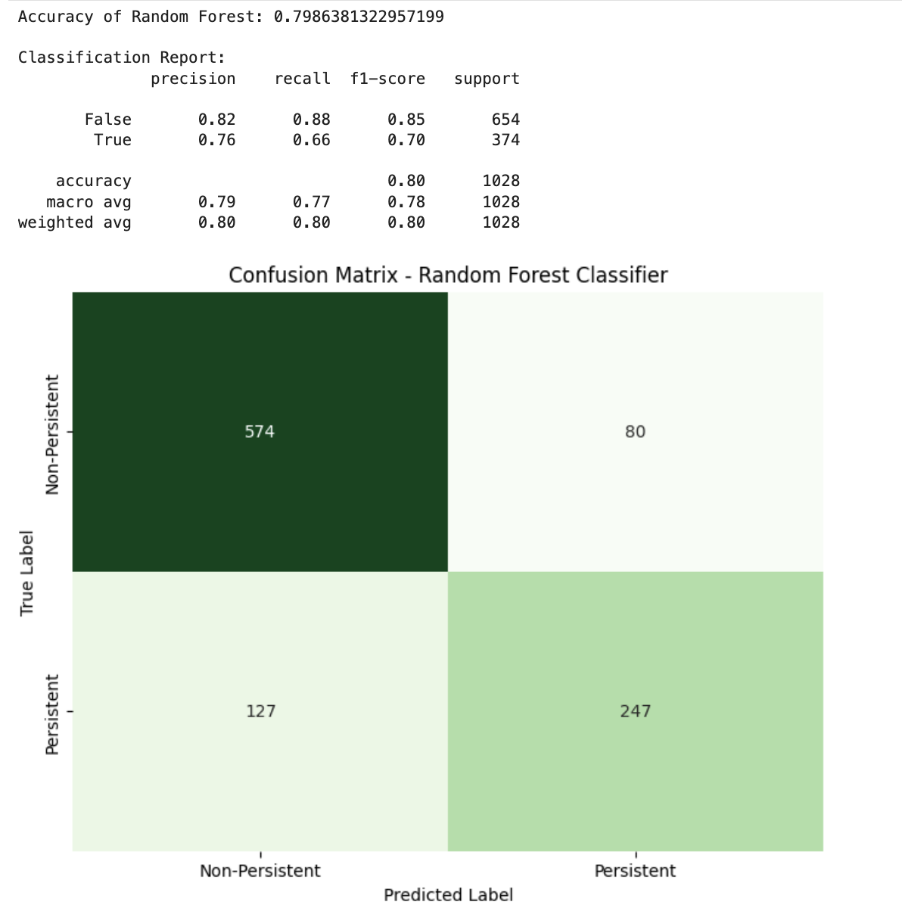
Technical Recommendations
Recommended Models for Persistency Prediction:
Logistic Regression (L2 Regularization):
Best suited for the dataset, offering a balance between interpretability and performance with an accuracy of 80%. This model allows us to pinpoint which features (e.g., DEXA scans, comorbidities) are the most predictive of persistency.
Random Forest:
Random Forest performed slightly lower than Logistic Regression but excels in capturing non-linear relationships. This model is recommended for exploring feature importance, particularly for categorical data like regions and comorbidities.
XGBoost:
Recommended for more complex, non-linear relationships. While not yet fully tested on this dataset, it is likely to outperform Logistic Regression and Random Forest in cases where feature interactions significantly impact persistency.

Slide 16
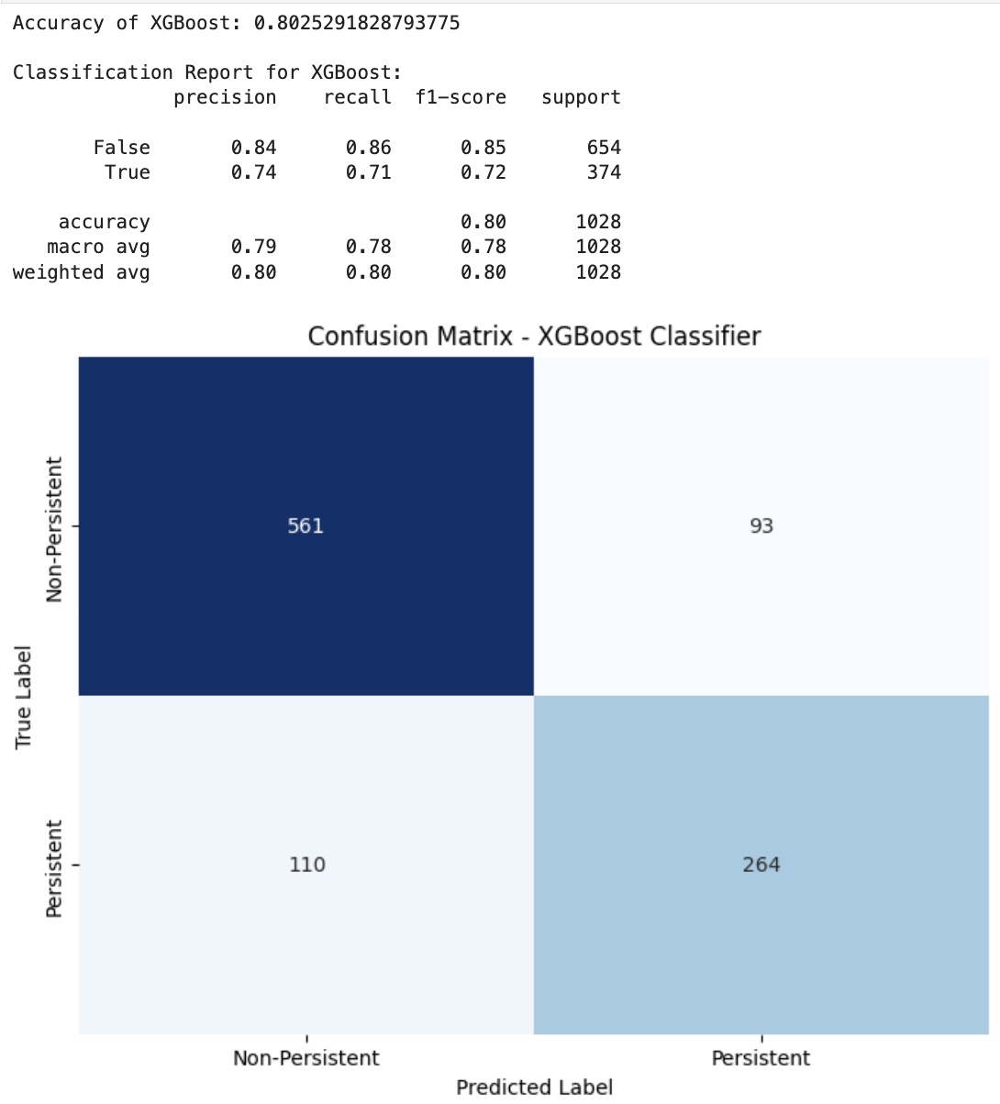
Technical Recommendations
Recommended Models for Persistency Prediction:
Logistic Regression (L2 Regularization):
Best suited for the dataset, offering a balance between interpretability and performance with an accuracy of 80%. This model allows us to pinpoint which features (e.g., DEXA scans, comorbidities) are the most predictive of persistency.
Random Forest:
Random Forest performed slightly lower than Logistic Regression but excels in capturing non-linear relationships. This model is recommended for exploring feature importance, particularly for categorical data like regions and comorbidities.
XGBoost:
Recommended for more complex, non-linear relationships. While not yet fully tested on this dataset, it is likely to outperform Logistic Regression and Random Forest in cases where feature interactions significantly impact persistency.

Slide 17
Conclusion
The analysis identified critical factors affecting drug persistency, such as comorbidities, long-term drug therapy, and Dexa administration. The Logistic Regression model achieved 80.1% accuracy, demonstrating its potential in identifying high-risk patients for ABC Pharma. This model can support targeted patient engagement and improve treatment adherence, while ongoing updates will ensure sustained accuracy and enhanced decision-making in patient care. Through this initial EDA report, there are sufficient reasons to contribute to this reseach and development stage of predictive drug persistency system onto official future deployment in the pharma industry.

Slide 18

Thank You
Shuyi Yu

